Slide 1

Vector spaces
ML LABS PVT LTD || WWW.ANALYTICS6.COM || DATA SCIENCE , AI , ML ,COMPUTER VISION || TRAINING AND CONSULTING
Phone Number : 91-6362546088 || Email : contact@analytics6.com

Slide 2
Agenda
Introduction
Subspaces
Linear Transformation
Span of a Set
Basis and Dimension
Rank and Nullity
ML LABS PVT LTD || WWW.ANALYTICS6.COM || DATA SCIENCE , AI , ML ,COMPUTER VISION || TRAINING AND CONSULTING
Phone Number : 91-6362546088 || Email : contact@analytics6.com

Slide 3
Introduction
A vector space (also called a linear space) is a set of objects called vectors, which may be added together and multiplied ("scaled") by numbers, called scalars. Scalars are often taken to be real numbers, but there are also vector spaces with scalar multiplication by complex numbers, rational numbers, or generally any field.
ML LABS PVT LTD || WWW.ANALYTICS6.COM || DATA SCIENCE , AI , ML ,COMPUTER VISION || TRAINING AND CONSULTING
Phone Number : 91-6362546088 || Email : contact@analytics6.com

Slide 4
Introduction
There are two types of physical quantities:
Scalars = quantities that can be described by numerical value alone (Ex: temperature, length, speed)
Vectors = quantities that require both a numerical value and direction (Ex: velocity, force,…)
ML LABS PVT LTD || WWW.ANALYTICS6.COM || DATA SCIENCE , AI , ML ,COMPUTER VISION || TRAINING AND CONSULTING
Phone Number : 91-6362546088 || Email : contact@analytics6.com

Slide 5
Definition
A non empty set v is said to be a vector space over a field F if
V is an abelian group under an operations called addition which we denoted by +.
ML LABS PVT LTD || WWW.ANALYTICS6.COM || DATA SCIENCE , AI , ML ,COMPUTER VISION || TRAINING AND CONSULTING
Phone Number : 91-6362546088 || Email : contact@analytics6.com

Slide 6
Definition
For every α ∈ F and v ∈ V , there is defined an element αv in V subject to the following conditions.
a) α(u + v) = αu + αv for all u, v ∈ V and α ∈ F.
b) (α + β )u = αu + βu for all u ∈ V and α ,β ∈ F
c) α (βu) = (α β )u for all u ∈ V and α, β ∈ F.
d) 1u = u for all u ∈ V.
ML LABS PVT LTD || WWW.ANALYTICS6.COM || DATA SCIENCE , AI , ML ,COMPUTER VISION || TRAINING AND CONSULTING
Phone Number : 91-6362546088 || Email : contact@analytics6.com

Slide 7
Subspaces
Let V be a vector space over a field F. A non-empty subset W of V is called a subspace of V if W itself is a vector space over F under the operations of V.
Let V be a vector space, and let W be a subset of V. If W is a vector space with respect to the operations in V, then W is called a subspace of V.
ML LABS PVT LTD || WWW.ANALYTICS6.COM || DATA SCIENCE , AI , ML ,COMPUTER VISION || TRAINING AND CONSULTING
Phone Number : 91-6362546088 || Email : contact@analytics6.com

Slide 8
Subspaces
Theorem: Let V be a vector space, with operations + and ·, and let W be a subset of V. Then W is a subspace of V if and only if the following conditions hold.
Sub0 W is nonempty: The zero vector belongs to W.
Sub1 Closure under +: If u and v are any vectors in W, then u + v is in W.
Sub2 Closure under ·: If v is any vector in W, and c is any real number, then c · v is in W.
ML LABS PVT LTD || WWW.ANALYTICS6.COM || DATA SCIENCE , AI , ML ,COMPUTER VISION || TRAINING AND CONSULTING
Phone Number : 91-6362546088 || Email : contact@analytics6.com

Slide 9
Linear transformation
Let V and W be a vector spaces over a field F .A mapping T : V → W is called a homomorphism . A homomorphism T of vector spaces is also called a linear transformation.
ML LABS PVT LTD || WWW.ANALYTICS6.COM || DATA SCIENCE , AI , ML ,COMPUTER VISION || TRAINING AND CONSULTING
Phone Number : 91-6362546088 || Email : contact@analytics6.com

Slide 10
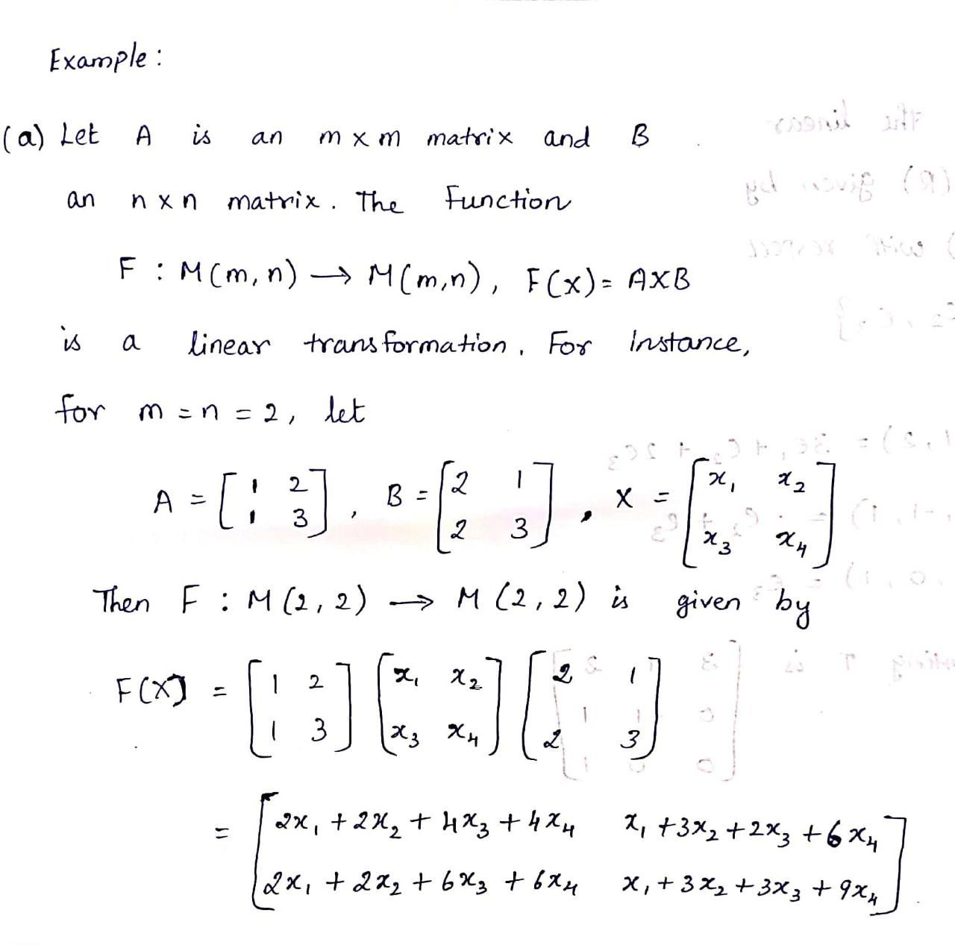
Linear transformation
Example:
ML LABS PVT LTD || WWW.ANALYTICS6.COM || DATA SCIENCE , AI , ML ,COMPUTER VISION || TRAINING AND CONSULTING
Phone Number : 91-6362546088 || Email : contact@analytics6.com

Slide 11
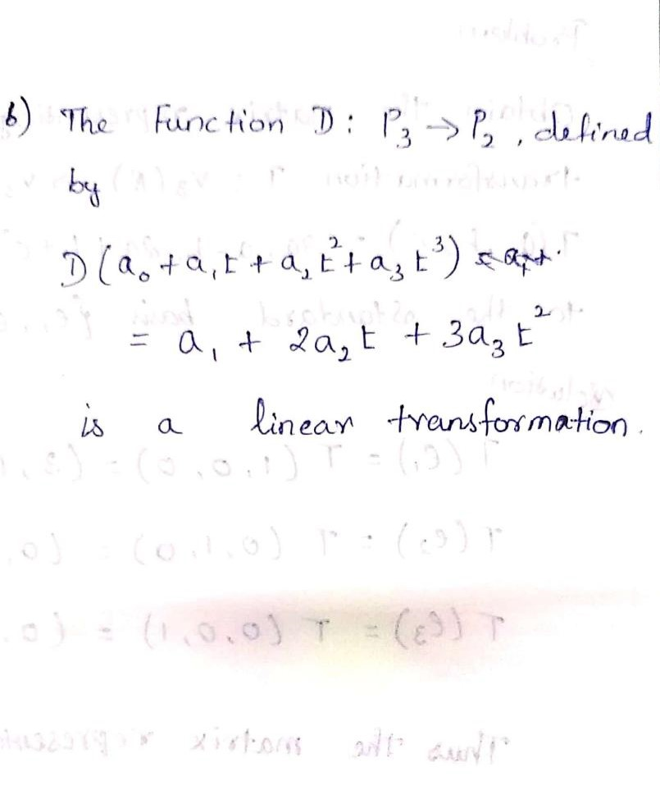
Linear transformation
Example:
ML LABS PVT LTD || WWW.ANALYTICS6.COM || DATA SCIENCE , AI , ML ,COMPUTER VISION || TRAINING AND CONSULTING
Phone Number : 91-6362546088 || Email : contact@analytics6.com

Slide 12
Span of a Set
Definition:
Let V be a vector space over a field F.
Let v1,v2,…..,vn ∈ V. Then an element of the form α1v1 + α2v2 + …. + αnvn where αi ∈ F is called a linear combination of the vectors v1, v2,…., vn.
ML LABS PVT LTD || WWW.ANALYTICS6.COM || DATA SCIENCE , AI , ML ,COMPUTER VISION || TRAINING AND CONSULTING
Phone Number : 91-6362546088 || Email : contact@analytics6.com

Slide 13
Span of a Set
Definition:
Let S be a non-empty subset of a vector space V. Then the set of a vector space V. Then the set of all linear combinations of finite sets of elements of S is called the linear span of S and is denoted by L(s).
ML LABS PVT LTD || WWW.ANALYTICS6.COM || DATA SCIENCE , AI , ML ,COMPUTER VISION || TRAINING AND CONSULTING
Phone Number : 91-6362546088 || Email : contact@analytics6.com

Slide 14
Basis and Dimension
Definition:
A linearly independent subset S of a vector space V which spans the whole space V is called a basis of the vector space.
Let V be a finite dimensional vector space over a field F. The number of elements in any basis of V is called the dimension of V is called the dimension of V and is denoted by dim V.
ML LABS PVT LTD || WWW.ANALYTICS6.COM || DATA SCIENCE , AI , ML ,COMPUTER VISION || TRAINING AND CONSULTING
Phone Number : 91-6362546088 || Email : contact@analytics6.com

Slide 15
Rank and Nullity
Definition:
Let T : V → W be a linear transformation. Then the dimension of T(V) is called the rank of T. The dimension of key T is called the nullity of T.
A linear transformation T : V → W is called non-singular if T is 1-1; otherwise T is called singular.
ML LABS PVT LTD || WWW.ANALYTICS6.COM || DATA SCIENCE , AI , ML ,COMPUTER VISION || TRAINING AND CONSULTING
Phone Number : 91-6362546088 || Email : contact@analytics6.com

Slide 16
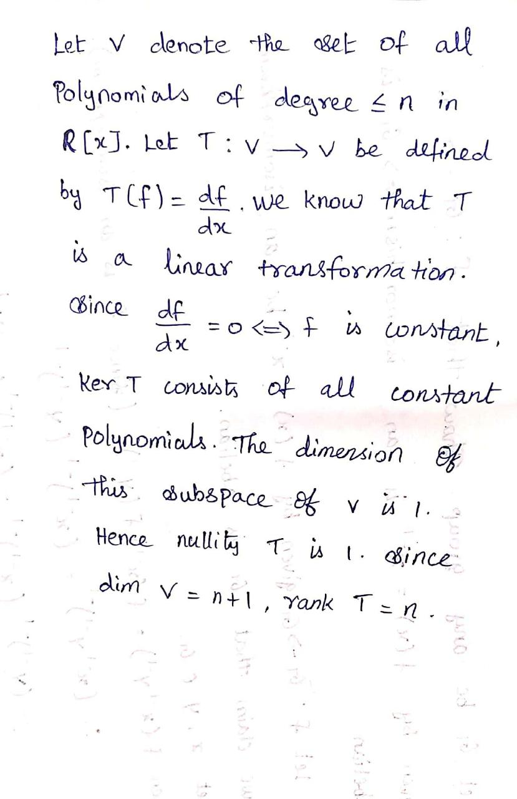
Rank and Nullity
Example :
ML LABS PVT LTD || WWW.ANALYTICS6.COM || DATA SCIENCE , AI , ML ,COMPUTER VISION || TRAINING AND CONSULTING
Phone Number : 91-6362546088 || Email : contact@analytics6.com

Slide 17
Matrix of a linear Transformation
Definition :
Let A = (aij) and B = (bij) be two m x n matrices. We defined the sum of these two matrices by A+B =(aij +bij).
Let A = (aij) be an arbitrary matrix over a field F. let α ∈ F . We define αA = (αaij)
ML LABS PVT LTD || WWW.ANALYTICS6.COM || DATA SCIENCE , AI , ML ,COMPUTER VISION || TRAINING AND CONSULTING
Phone Number : 91-6362546088 || Email : contact@analytics6.com

Slide 18
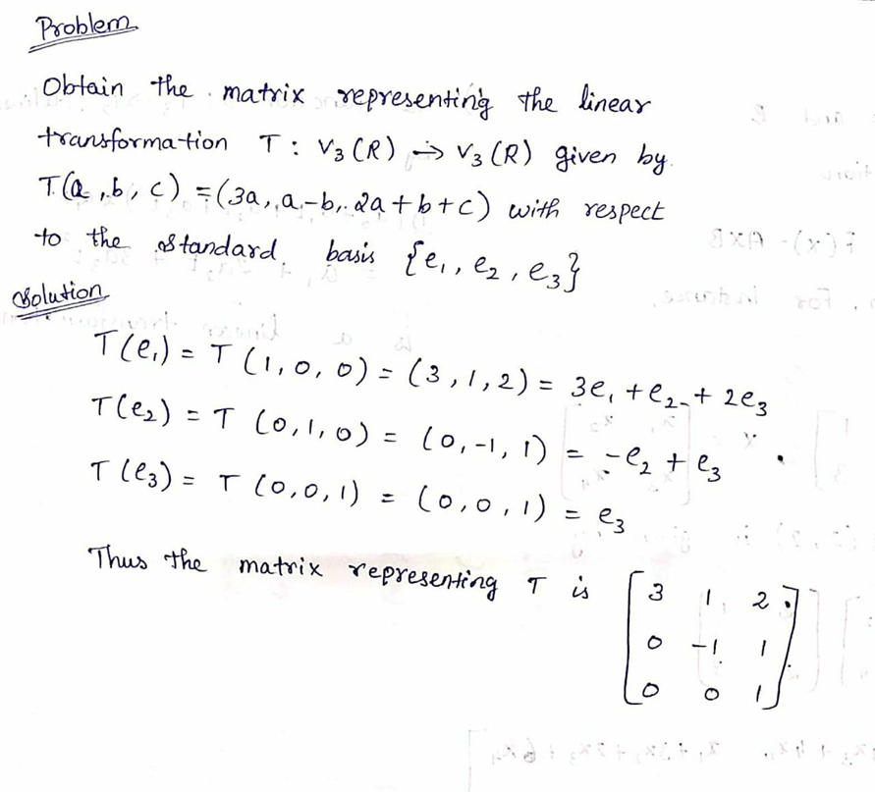
Matrix of a linear Transformation
ML LABS PVT LTD || WWW.ANALYTICS6.COM || DATA SCIENCE , AI , ML ,COMPUTER VISION || TRAINING AND CONSULTING
Phone Number : 91-6362546088 || Email : contact@analytics6.com

